Slide 1
SAM VARIANTS and REsults
Prajyot Kore, prajyot@ripik.ai

Slide 2
SAM VAriants
Model Name | Resolution
SAM-h | 1024x1024
SAM-L | 1024x1024(check)
SAM-B | 1024x1024(check)
EfficientVit-SAM -l1 | 512x512
EfficientVit-SAM -l2 | 512x512
EfficientVit-SAM -xl0 | 1024x1024
EfficientVit-SAM -xl1 | 1024x1024
Slim-SAM-uniform-50 | 1024x1024(check)
Slim-SAM-uniform-77 | 1024x1024(chcek

Slide 3
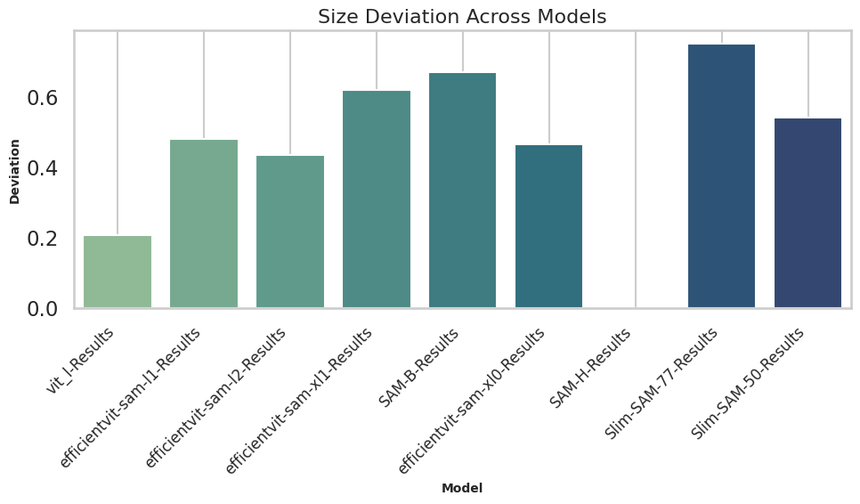
Size Deviation from SAM-H

Slide 4
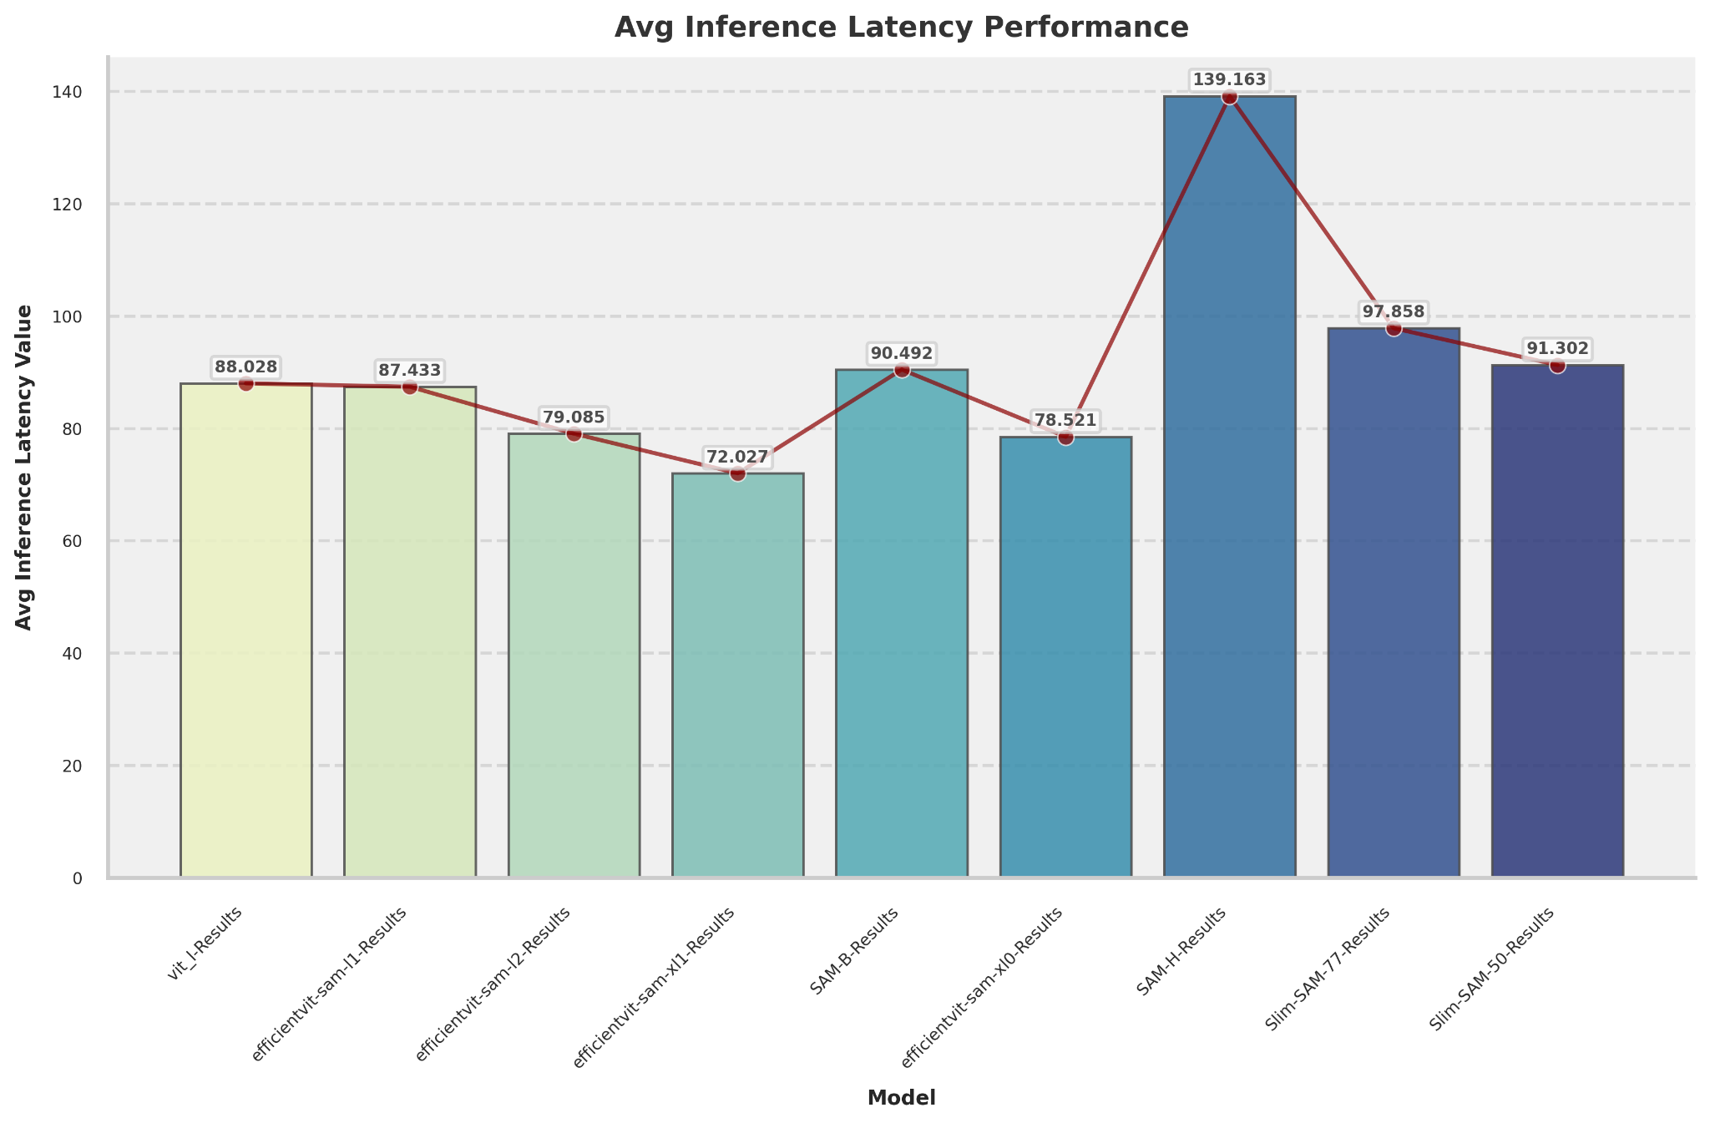
2. Inference Latency

Slide 5
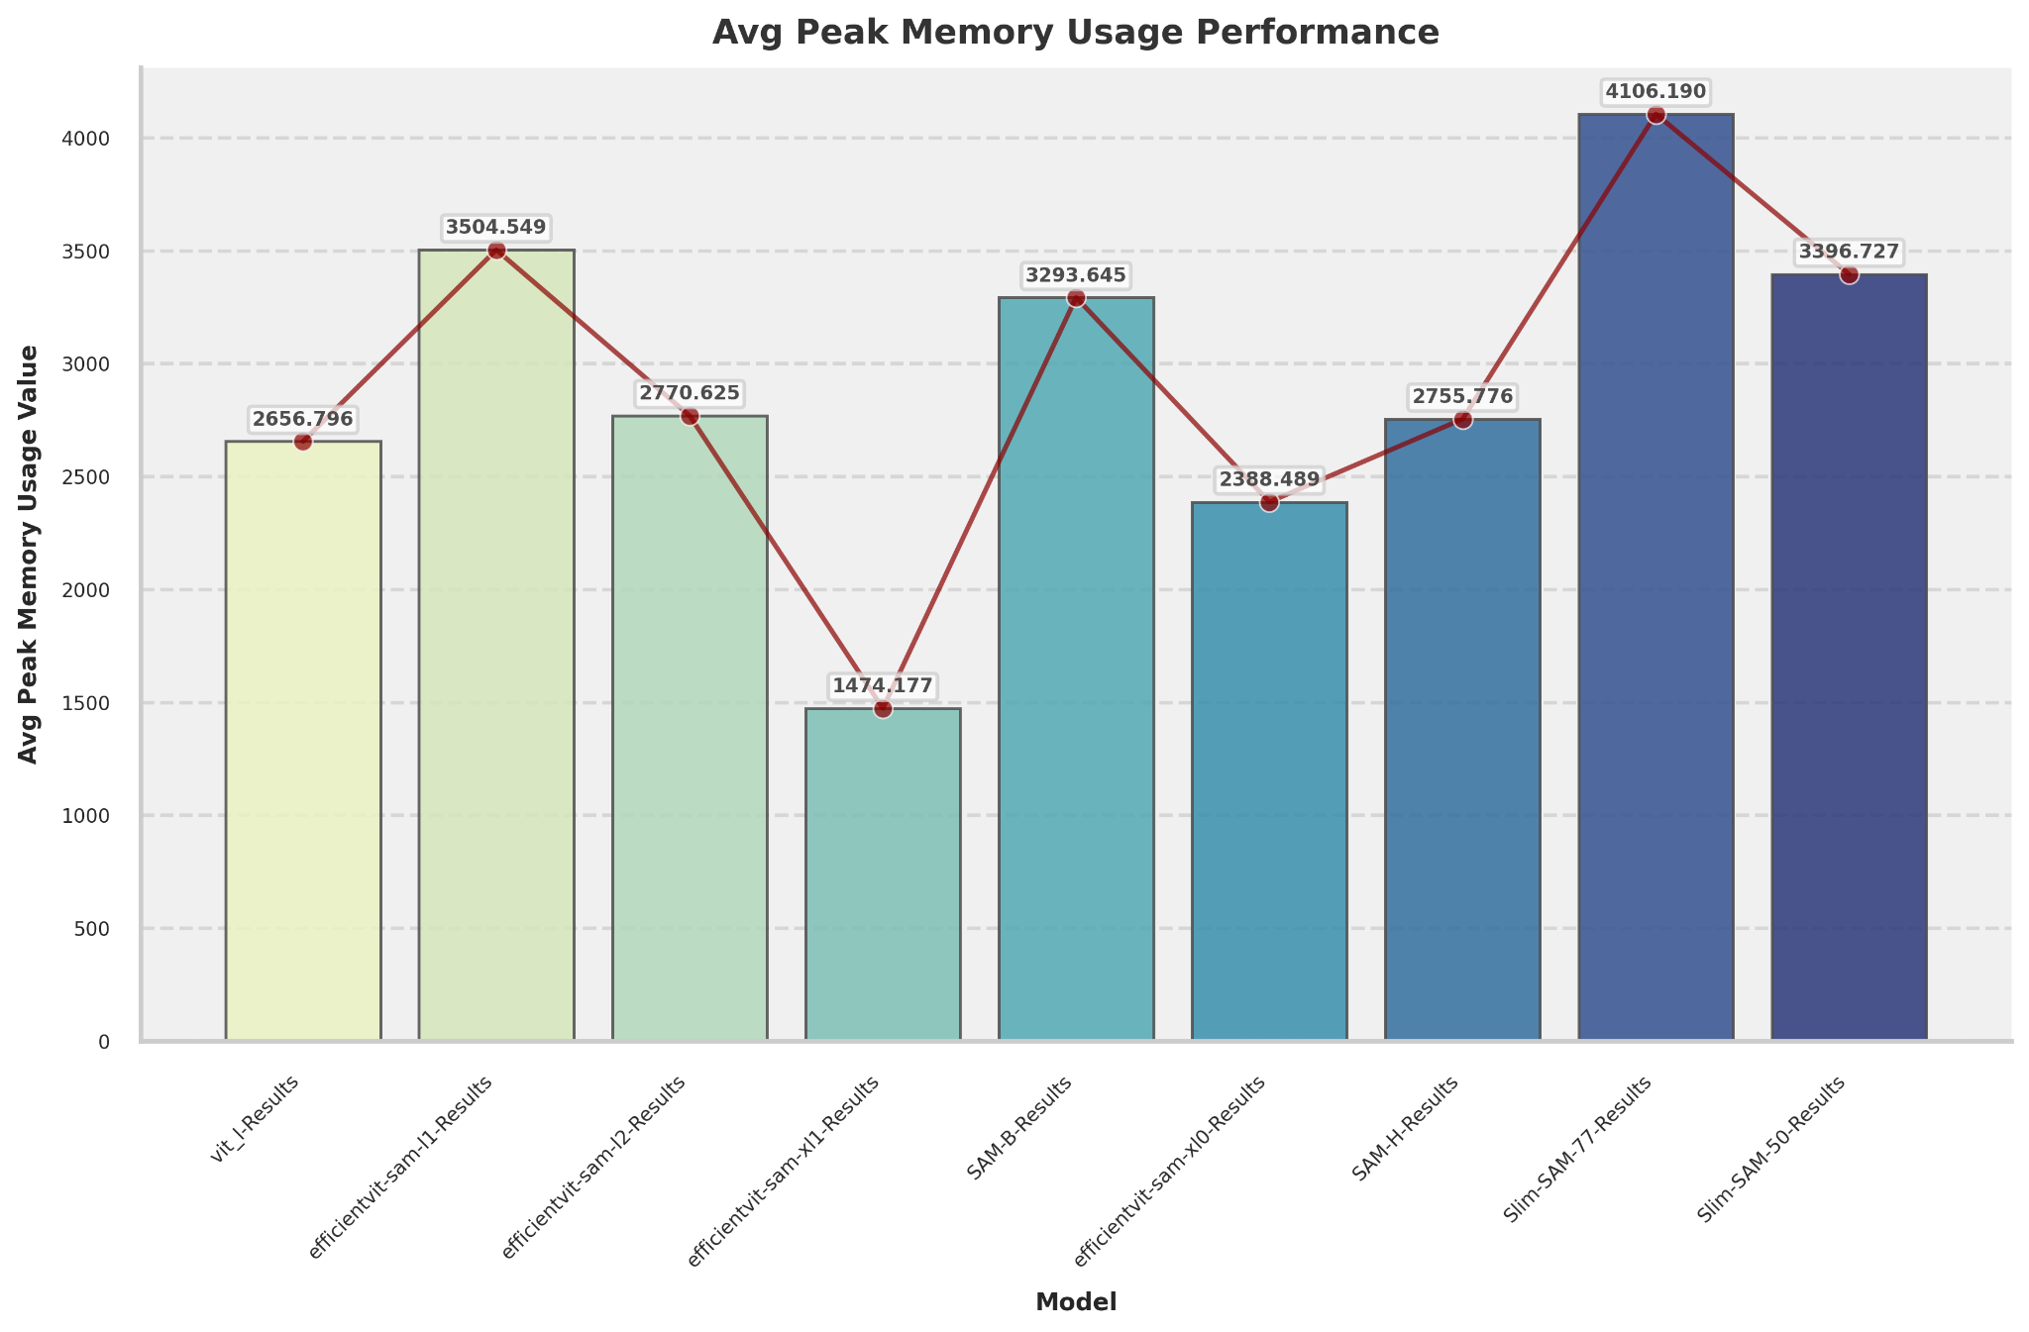
5. AVg MAx Memory Usage

Slide 6
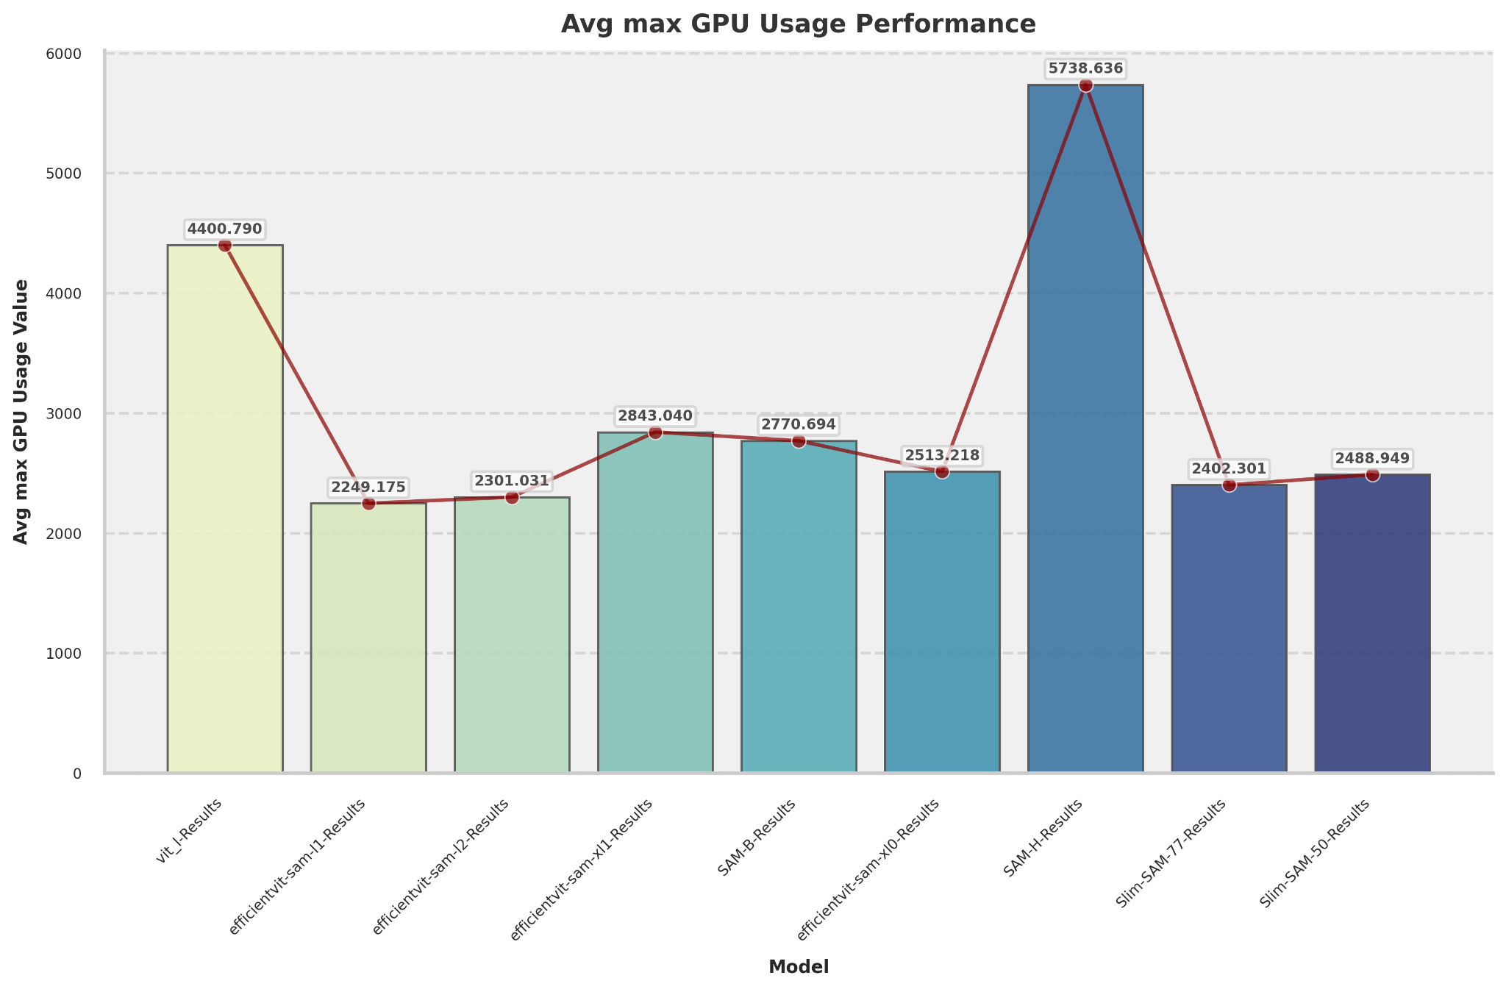
3. Avg Max GPU Utilization (MB)

Slide 7
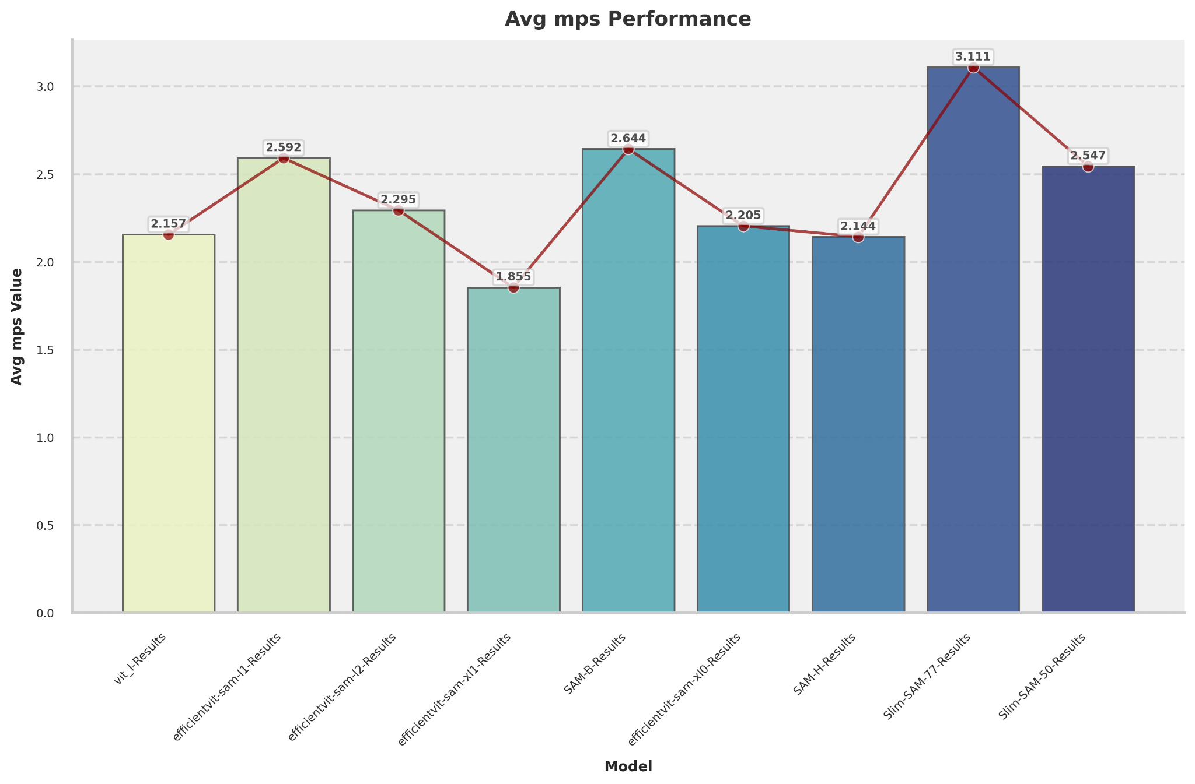
4. Avg mpg values

Slide 8
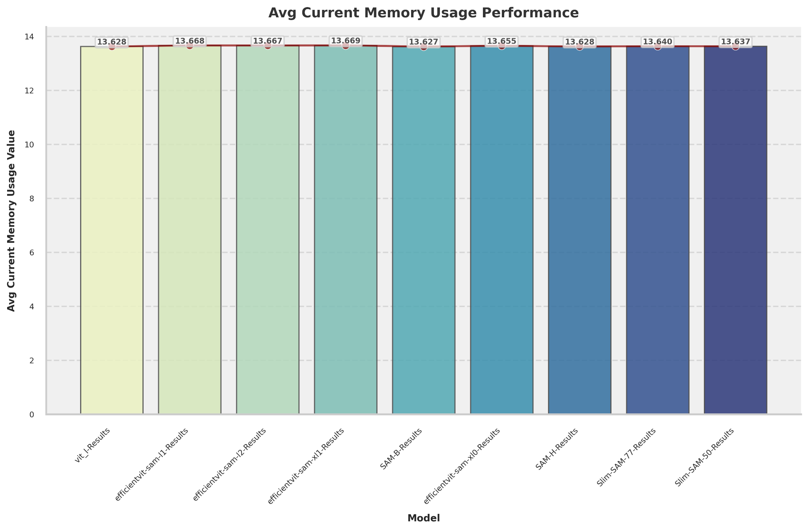
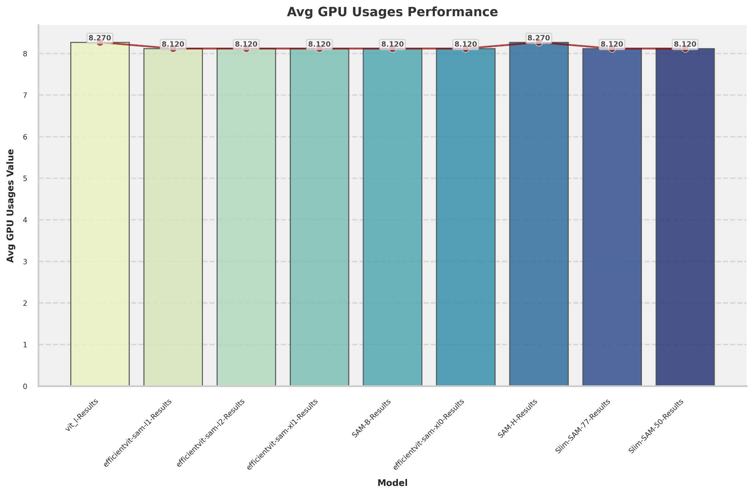
6. Current Memory and GPU Usage

Slide 9
Segmented Images

Slide 10
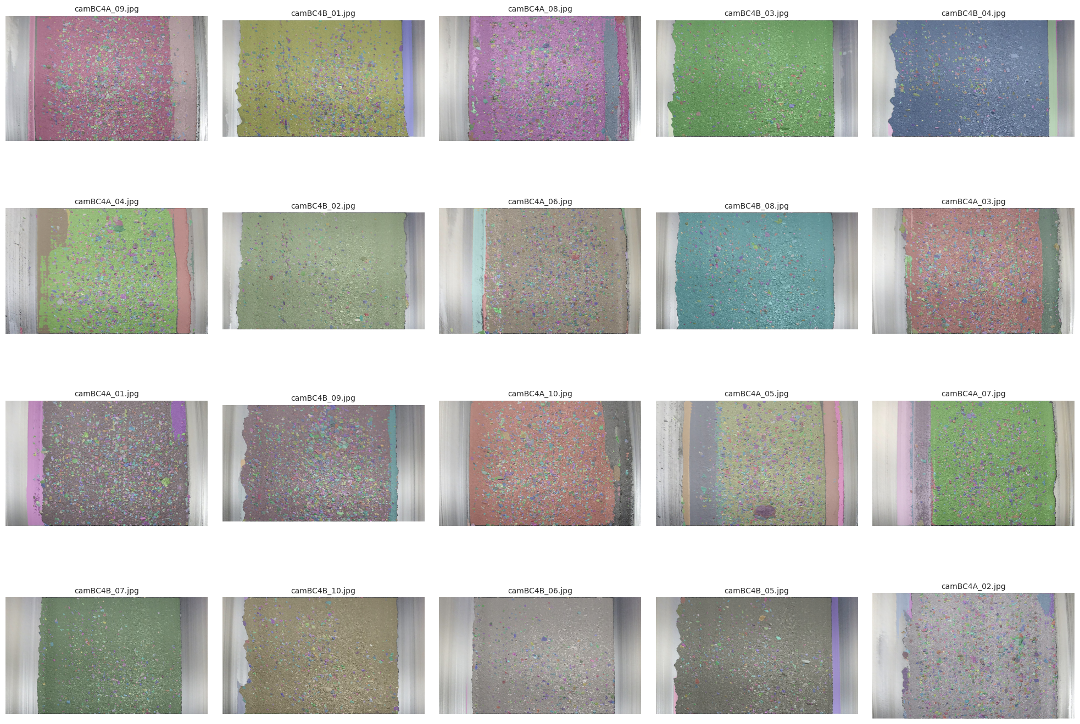
1. Original (SAM-H)

Slide 11
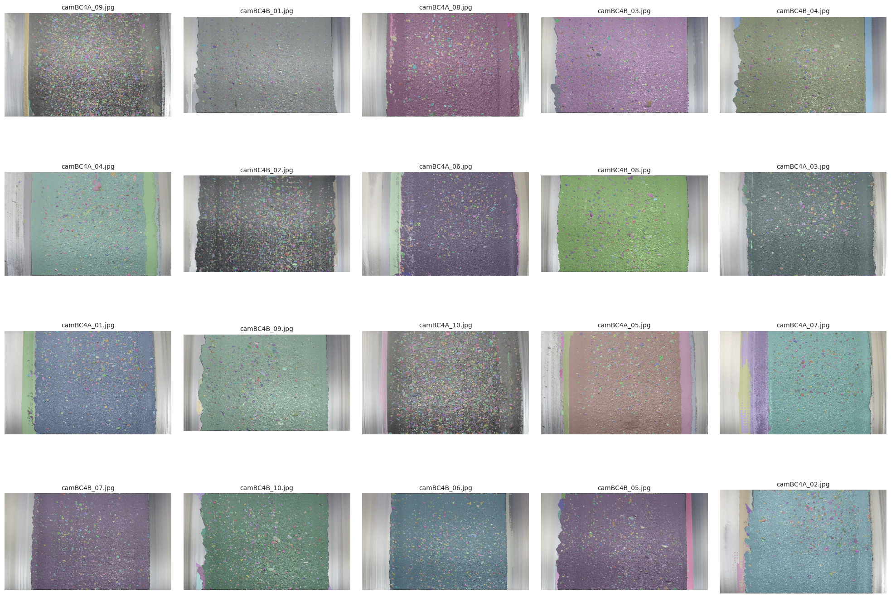
2. SAM-B

Slide 12
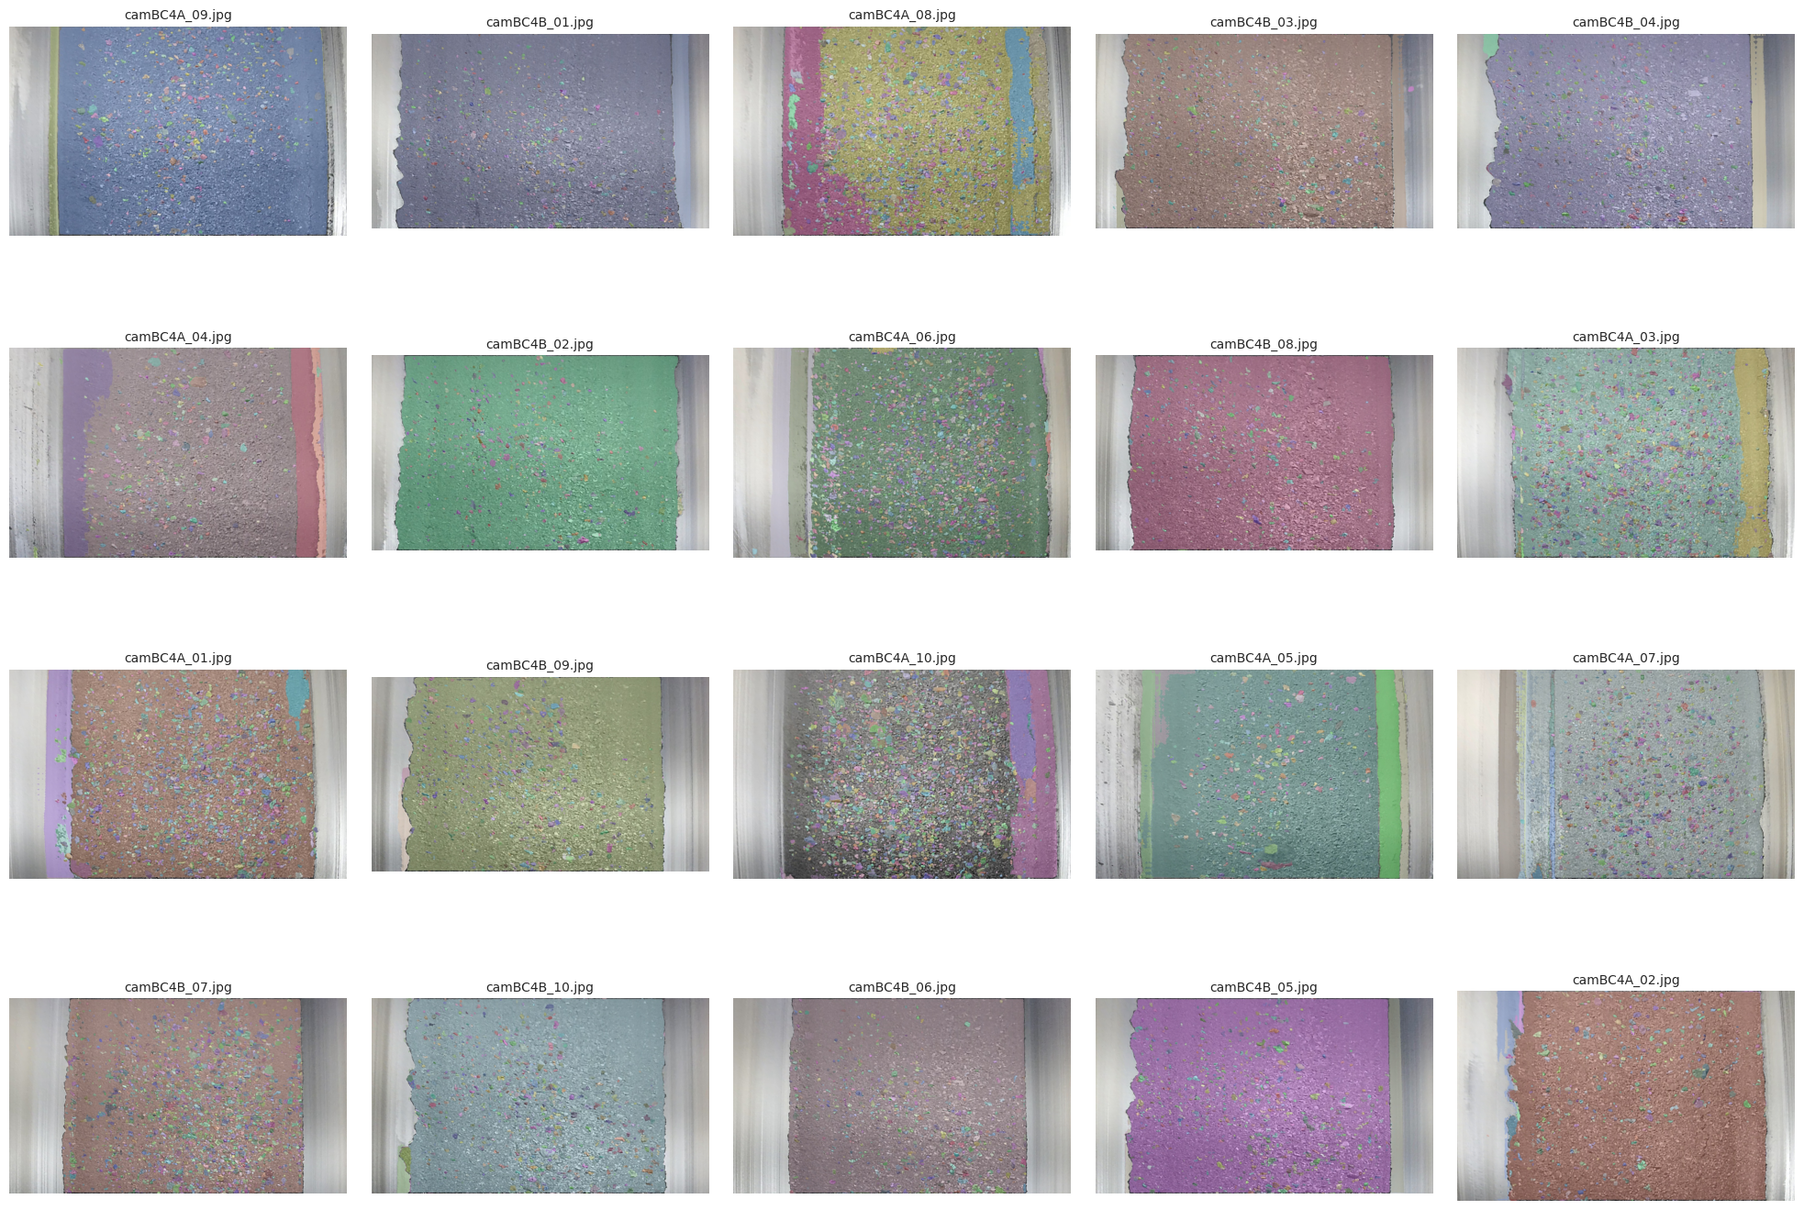
3. SAM-L

Slide 13
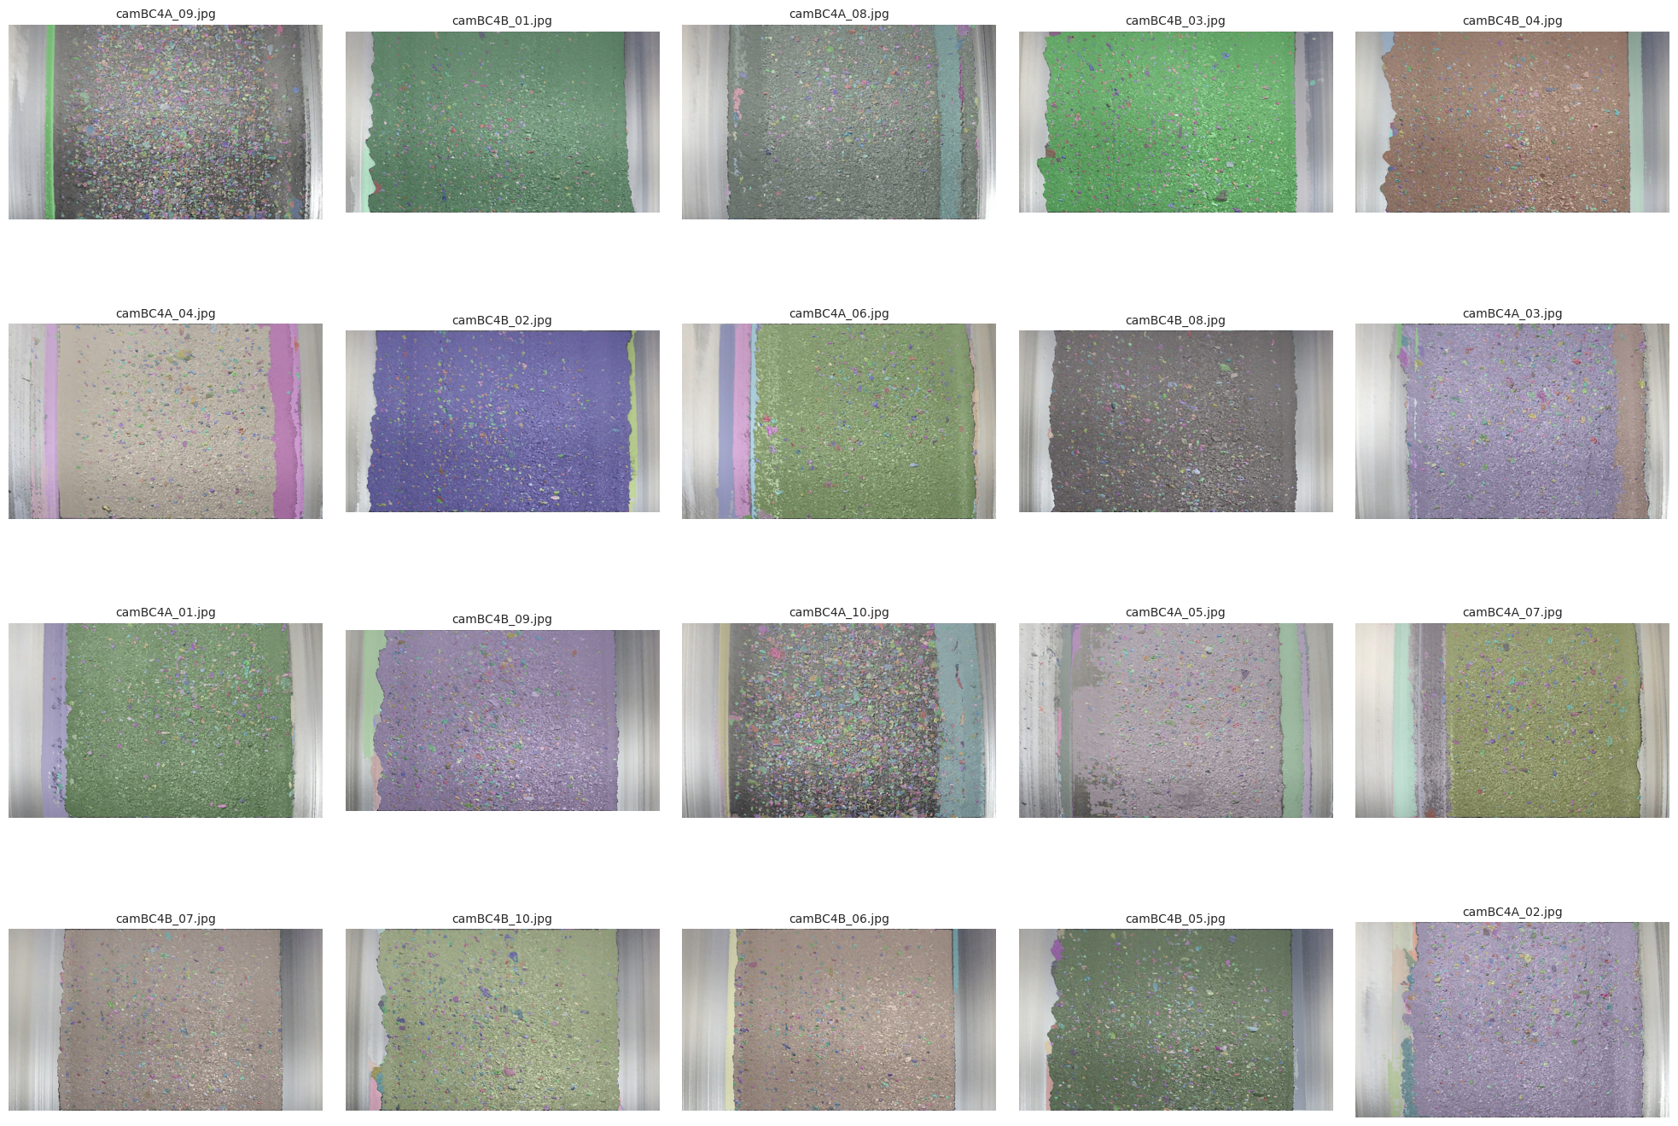
4. Slim-sAM 50

Slide 14
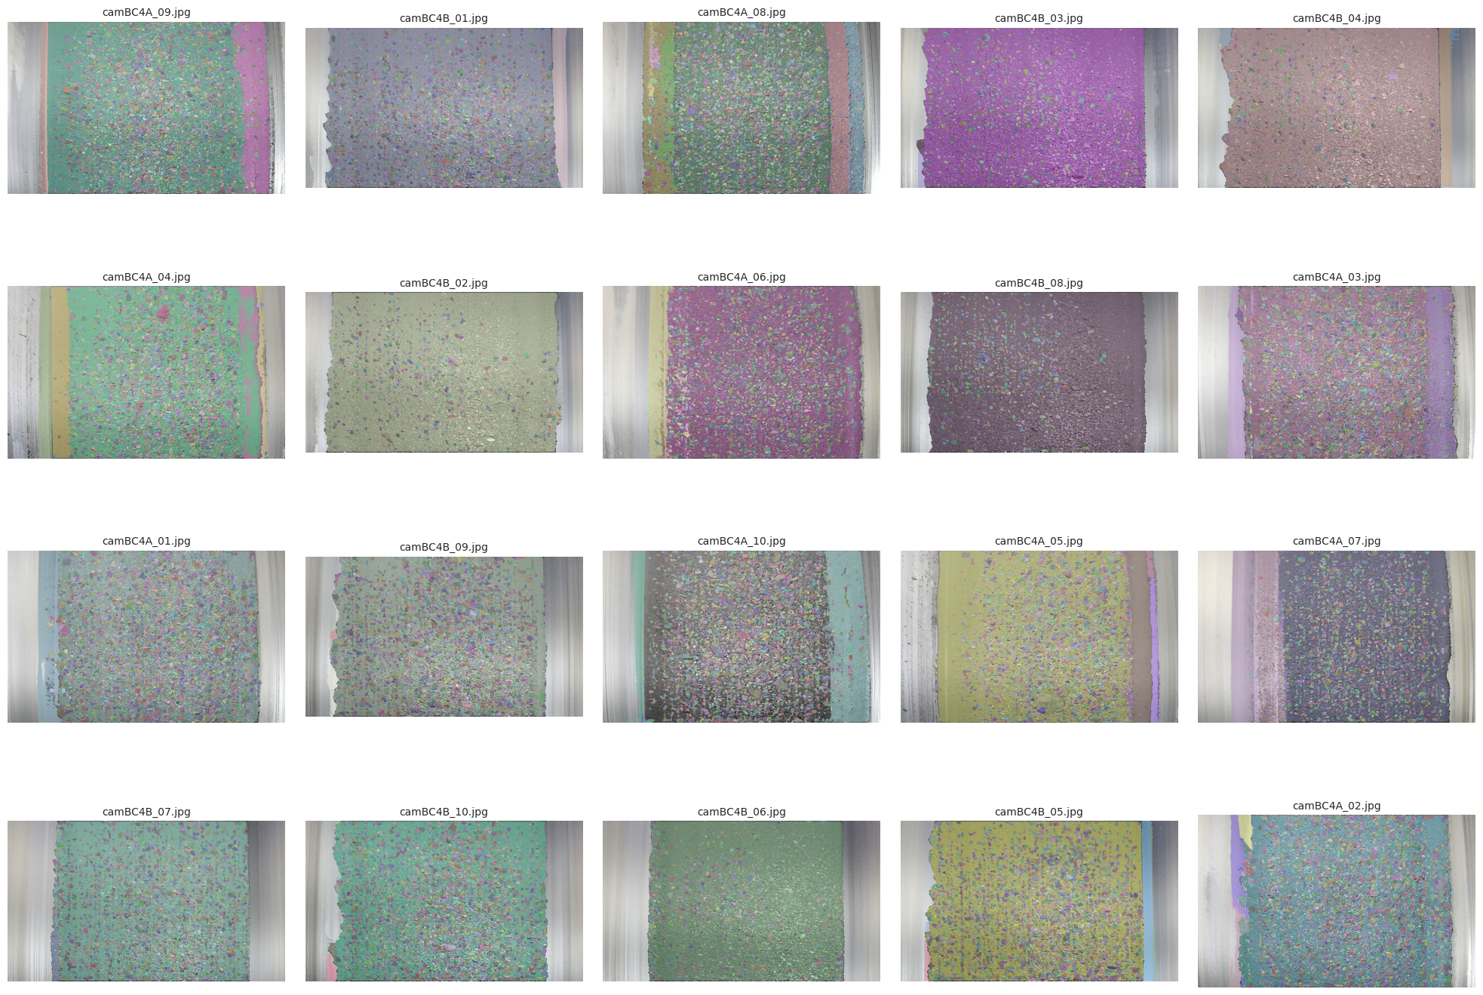
5. Efficient-l1

Slide 15
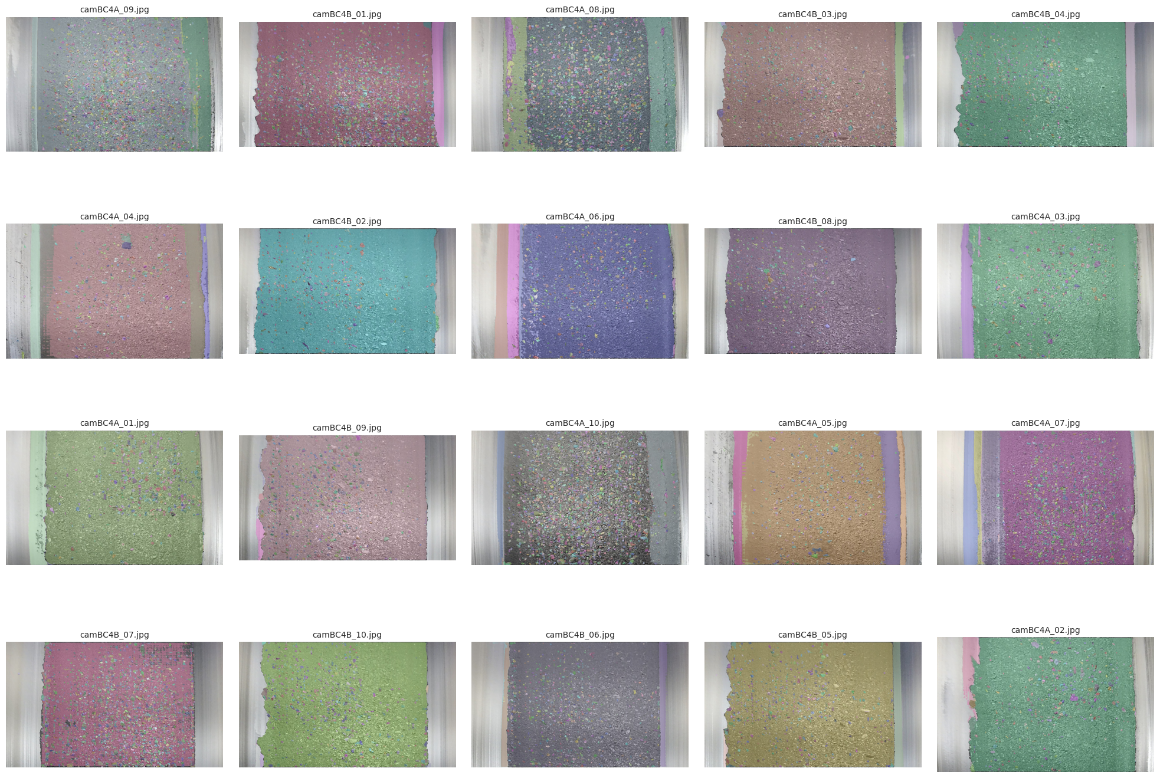
6. EfficientVit-l2

Slide 16
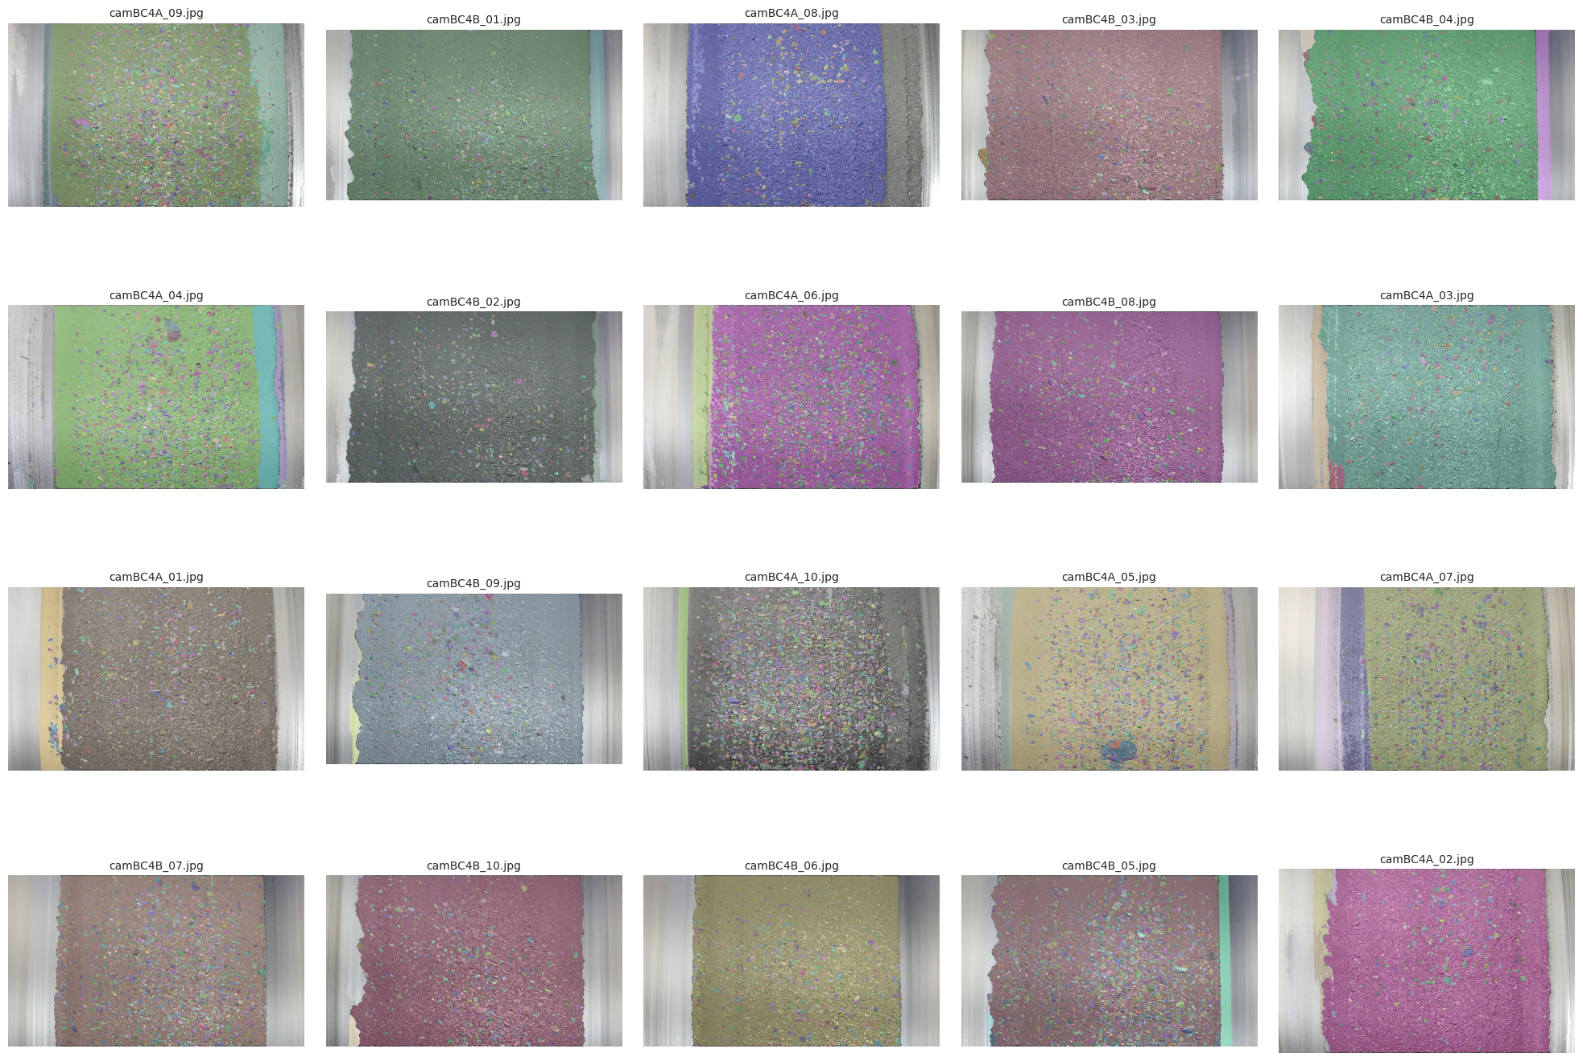
7. Efficientvit-xl0

Slide 17
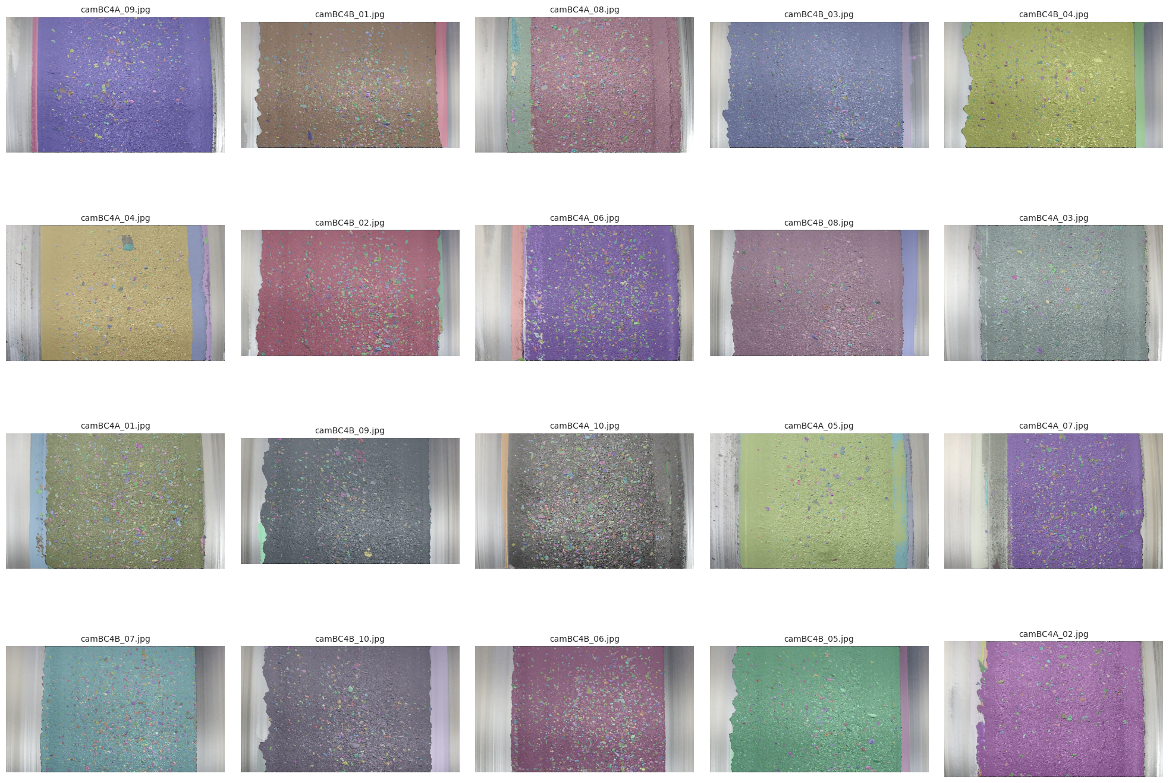
8. Efficientvit-xl1

Slide 18
Resource:
Combined result

